Slide 2
Agenda
Timeline
Training Session
Data Science Project
Industrial Event
Data Science Competition
Getting Help

Slide 3
Timeline
 | 22nd Feb | 29th Feb | 7th March | 14th March | 21st March | 28th March - 2nd May | 9th May | 16th May | 23th May | 30th May
Programme Briefing
GDO Training Workshops
Release of self-paced material
Workshop and Help sessions
Data Science Project
Industrial speaker events
Data Science Competition

Slide 4
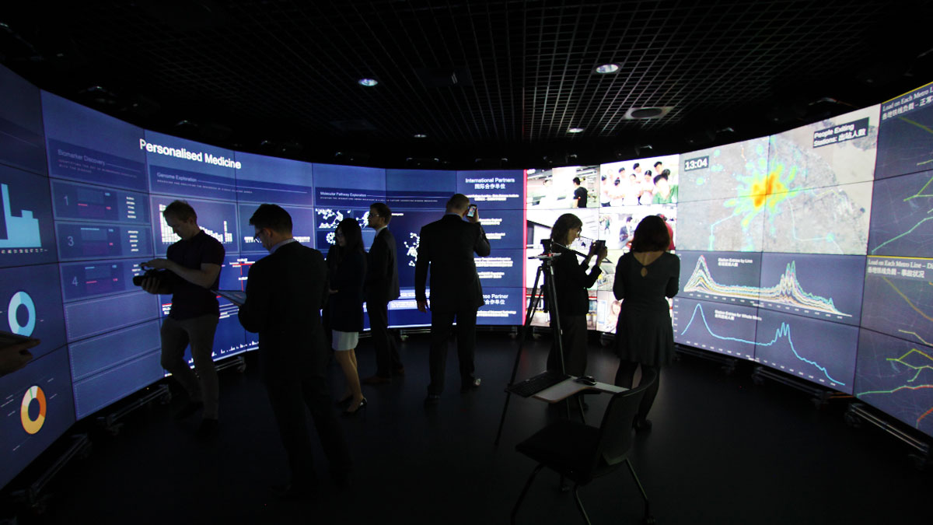
GDO Training Workshops
First Session – Date: 9th March 4.00pm-5.15pm Venue: Data Science Institute
Second Session – Date: TBD Venue: Data Science Institute

Slide 5
Self-paced material (Weekly)
Components of material
Lecture Slides
Reveal.js
Discuss subject from high-level perspective
Quick overview of topics
Hands-on Teaching Material
Jupyter notebook
Dive into the problem, description (any formulas and theories), codes and results.
Homework
HackerRank
Practice learnt materials (It can change as we want to find Online Judge that allows to measure accuracy instead of only accepting by test cases)
Feedback
Individual homework feedback from the last week (after week 2)

Slide 6
Self-paced material (Weekly)
Self-paced material published this week on Fri, for the next weeks we will aim for Mondays.
Week 1 (Fri 26th Feb, 10am) :
Introduction to Data Science
Stack and toolkit
Data analytics examples from real world
Week 2 (Mon 29th Feb, 10am) :
Data integration and exploration
Part 1 of time-series financial analysis
NYSE exchange data
Multiprocessing in Python, Pandas and Spark intro
Week 3 (Mon 7th Mar, 10am) :
Solution development, knowledge management, and ownership of data product
Part 2 of time-series financial analysis
NYSE exchange data
Advanced Spark

Slide 7
Self-paced material (Weekly)
Self-paced material published this week on Fri, for the next weeks we will aim for Mondays.
week 4 (Mon 14th Mar, 10am):
Advanced Machine learning
Dealing with really large data sets
Wikipedia data
Spark MLLib
week 5 (Mon 21st Mar, 10am) :
Working with graphs analysis
Spark GraphX, Neo4j,

Slide 8
Workshops and Help Sessions
First Session Date: Wednesday, 9th March Venue: TBA
13.00 – 14.00 PM : 1 hour to help with the data science project
14.00 – 16.00 PM : 2 hours to help with 2nd part of financial data analysis
16.00 – 17.15 PM : 1.5 hours GDO Training
Second Session Date: Wednesday, 11th May Venue: TBA
13.00 – 14.00 PM : 1 hour to help with the data science project and data visualization on GDO
Third Session Date: Wednesday, 19th May Venue: TBA
11.00 – 12.00 PM : 1 hour to help with the data science project
13.00 – 15.00 PM : 2 hours to cover advanced topic of choice (deep learning, stock movement prediction - from list of topics or proposed by students)

Slide 9

Data Science Project
Big data set (>50GB) - Require working from raw data set to finding pattern and creating a data product.
Data Integration
Data Exploration
Solution Development
Knowledge Management
Ownership of Data Product

Slide 10
Data Science Project
Presentation
Date: 19th May 3.00-4.00pm
Venue: Data Science Institute
Explain your data visualization in a 15-minute team presentation to be delivered at the Data Science Institute GDO on Wed, 19th May. Data Scientists from DSI will be voting on which team produces the best data visualization. The 15-minute limit will be strictly enforced, so practice to hit the mark. All members should be explaining in your presentation.
Project success criteria:
Originality (20%) - Project should be your idea and something new
Results found (20%) - Importance of your findings, you should be able to assess impact of the finding and understand what is important and what is not important. DS is a lot about cost optimisation.
Complexity (20%) - How much skills did you need to use, how did you use them, but results take priority you can shift skills to visualisation or product if finding was easy
Quality (20%) - The results are easy to understand and ready to be adopted. For example, quality of code, software and model (stability and correct use of technique)
Ownership (20%) - Is it viable solution, something that produces consistent value to various scenarios. Ability to solve the problem for any input data.

Slide 11

Industrial Event - Linkedin
Speaker: Ben Weeden (Insight – LinkedIn EMEA)
Date: 17th March 6.00-8.00pm
Venue: Imperial College Business School

Slide 12
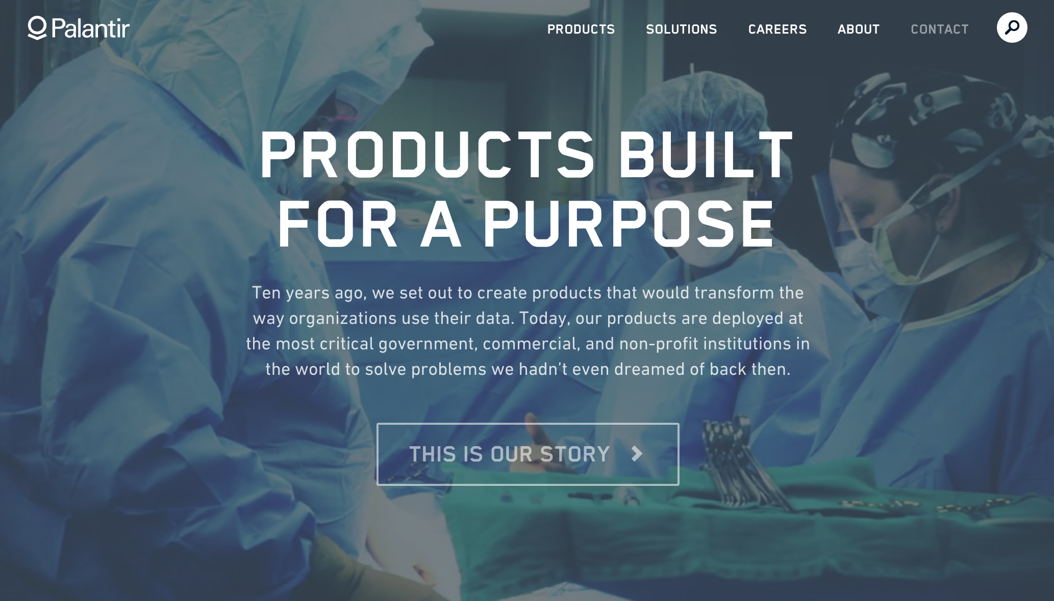
Industrial Event - Palantir
Speaker: TBD
Date: TBD
Venue: Imperial College Business School

Slide 13
Data Science Competition
Hack the Finance Industry in the Age of the Sharing Economy
Startupbootcamp FinTechFriday
Friday 18 March 2016 at 17:30 - Sunday, 20 March 2016 at 18:00 (GMT)
London, United Kingdom
http://www.eventbrite.co.uk/e/hack-the-finance-industry-in-the-age-of-the-sharing-economy-tickets-21775970514?aff=ebrowse
Hacking justice: data in the dock
Ministry of Justice Digital Team
Friday, 18 March 2016 at 18:00 - Sunday, 20 March 2016 at 18:00 (GMT)
The Ministry of Justice - 102 Petty France London, Greater London
https://www.eventbrite.co.uk/e/hacking-justice-data-in-the-dock-tickets-21721349140?aff=ebrowse
Others
http://dscomplete.com/icdss/competitions/
https://www.eventbrite.co.uk/d/united-kingdom--london/games/hackathon/

Slide 14
Getting Help
We will be supporting your project, competition preparation and seminar. Please contact us with any questions directly.
• Jaroslaw Hirniak (j@hirniak.com)
• Siangyang (Siangyang.lau15@imperial.ac.uk)
Feel free to post your questions on Slack!
Useful links:
Self-paced materials: http://dscomplete.com/course/
Datasets: http://dscomplete.com/datasets/
Programme Calendar: http://dscomplete.com/icdssadv/
Our Slack team : https://icdss-adv.slack.com/
Please also create your own Github account.

